Slide 1
Virtual Try-On:
Reported by:
G.Krishna kumari (N180655)
J.Gayatri (N181031)
D.Gayatri (N181056)
Sk.Sameena (N180263)
Md Salma (N180261)

Slide 2
Virtual try on contents
Abstract
Introduction
Problem definition:
Technologies used
Sample code
Output screenshots
Conclusion and references
Acknowledgement

Slide 3
Abstract
The virtual try-on project is a computer vision-based application that aims to revolutionize the retail industry by allowing customers to virtually try on accessories before making a purchase. Traditional shopping often poses challenges for customers, such as limited stock availability, sizing discrepancies, and the inability to physically try on products. Virtual try-on technology addresses these issues by leveraging computer vision algorithms to superimpose virtual accessories onto a user's image in real-time, creating an immersive and interactive shopping experience.

Slide 4
Introduction
Virtual try-on technology provides customers with an immersive and interactive shopping experience. It allows them to visualize how different items will look on their own body, helping them make more informed purchasing decisions. This enhances customer satisfaction and reduces the guesswork involved in online shopping.
By virtually trying on , customers gain confidence in their purchase decisions. They can assess the fit, style, and overall look of garments before committing to a purchase, reducing the likelihood of dissatisfaction and returns. This leads to higher customer retention and loyalty.

Slide 5
Project definition:
Problem Statement:
Develop a system that allows users to overlay virtual glasses and necklaces onto their images. Users can select different accessories and adjust their position, providing a basic representation of how they would look. The system should be user-friendly, compatible across devices, and optimized for smooth performance.
Deliverables:
User interface design and implementation
Image overlay functionality
Selection options for glasses and necklaces
Basic adjustment capabilities Preview and comparison features
Compatibility across devices and platforms

Slide 6
Technologies used:
IDE: pycharm
PyCharm is an Integrated Development Environment (IDE) specifically designed for Python development. It is developed by JetBrains, a renowned software development company. PyCharm provides a wide range of features and tools to facilitate efficient and productive Python programming.
PyCharm is available in two editions: PyCharm Community Edition (free and open-source) and PyCharm Professional Edition (commercial with additional advanced features).
Overall, PyCharm is a comprehensive and feature-rich IDE that empowers Python developers with a seamless development experience, boosting productivity and code quality.

Slide 7
Programming Language:Python
Python's versatility and rich ecosystem make it suitable for a wide range of applications, including web development, data analysis, scientific computing, artificial intelligence, machine learning, automation, and more. Its simplicity, readability, and extensive libraries have made Python a preferred choice for both beginners and experienced developers alike.
Python is a high-level, interpreted programming language known for its simplicity, readability, and versatility. It was created by Guido van Rossum and first released in 1991. Python has gained immense popularity in various domains, including web development, data analysis, machine learning, scientific computing, and automation.

Slide 8
Open cv
OpenCV (Open Source Computer Vision) is an open-source computer vision and machine learning library. It provides a comprehensive set of functions and algorithms for image and video processing, object detection and tracking, feature extraction, and more. OpenCV is widely used in various domains, including robotics, augmented reality, healthcare, surveillance, and automotive.
OpenCV is primarily written in C++, but it also provides APIs for Python, Java, and other programming languages. This allows developers to use OpenCV with their preferred programming languages and environments. Overall, OpenCV is a powerful and versatile library for computer vision tasks, offering a wide range of capabilities to developers and researchers in the field.

Slide 9
Dlib(Face_Recognition)
Dlib is a popular open-source library for computer vision, machine learning, and image processing. It provides a comprehensive set of tools and algorithms for various tasks, including face detection, facial landmark detection, face recognition, object detection and tracking, image segmentation, and more.
dlib includes highly accurate face detection algorithms, including a frontal face detector (get_frontal_face_detector())
dlib provides a powerful facial landmark detection algorithm (shape_predictor()) that can localize key points on a face, such as eyes, nose, mouth, and jawline. This allows for various applications, including face alignment, expression analysis, and facial feature-based recognition.

Slide 10
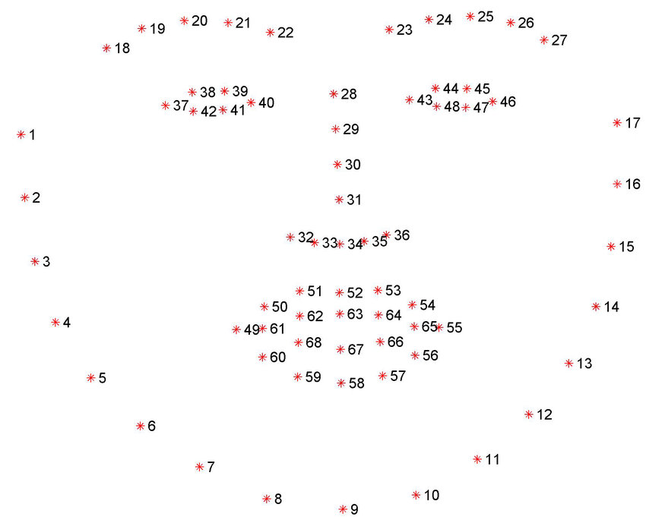
Shape predictor 68 face landmarks:

Slide 11
Python Framework: (PyQt5)
PyQt5 is a Python binding for the Qt framework, which is a popular and powerful cross-platform application development framework. PyQt5 allows developers to create graphical user interfaces (GUIs) for desktop applications using Python.
PyQt5 offers extensive documentation, tutorials, and community support, making it a popular choice for developing desktop applications with Python and Qt. It provides a robust and flexible framework for creating modern and user-friendly graphical interfaces for a wide range of use cases.
PyQt5 enables the development of cross-platform applications that can run on different operating systems, such as Windows, macOS, and Linux, without significant modifications. This is because it is built on the Qt framework, which provides a consistent API and functionality across platforms.

Slide 12
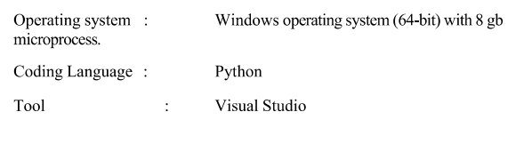
Software Requirements:

Slide 13
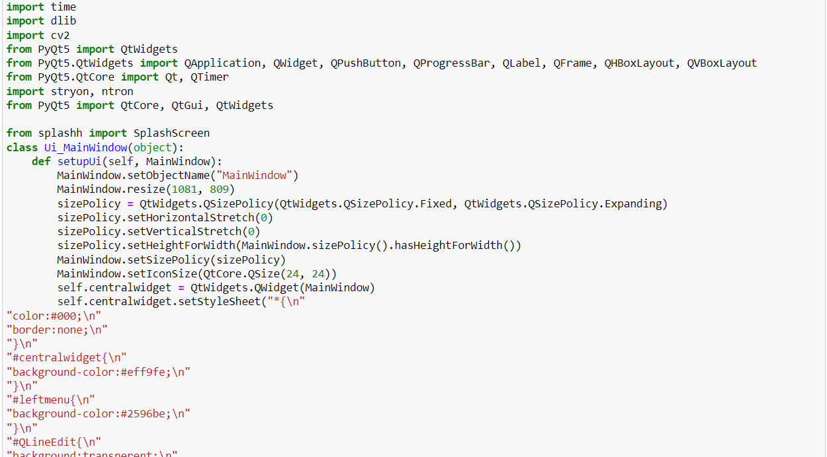
Sample Code:
@User Interface

Slide 14
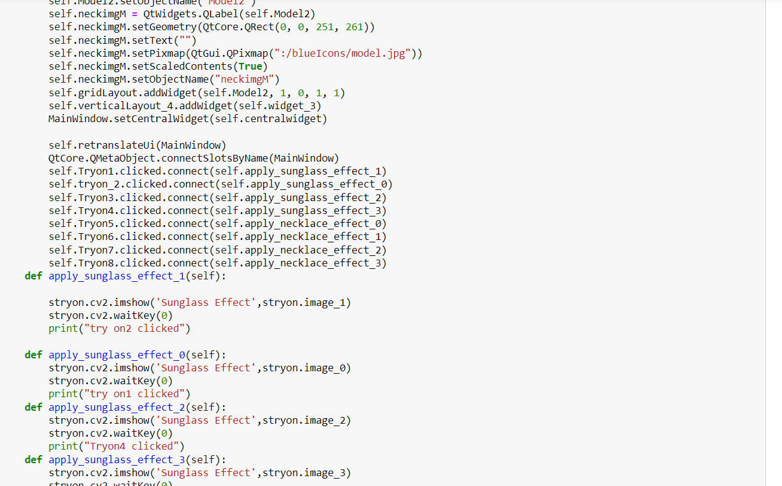
Backend connection

Slide 15
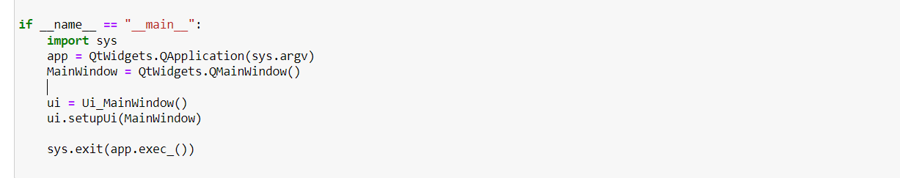

Slide 16
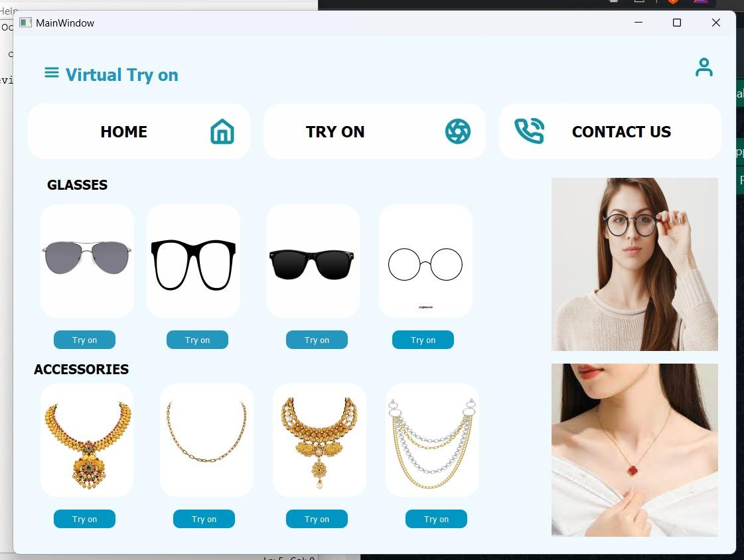
User Interface:

Slide 17
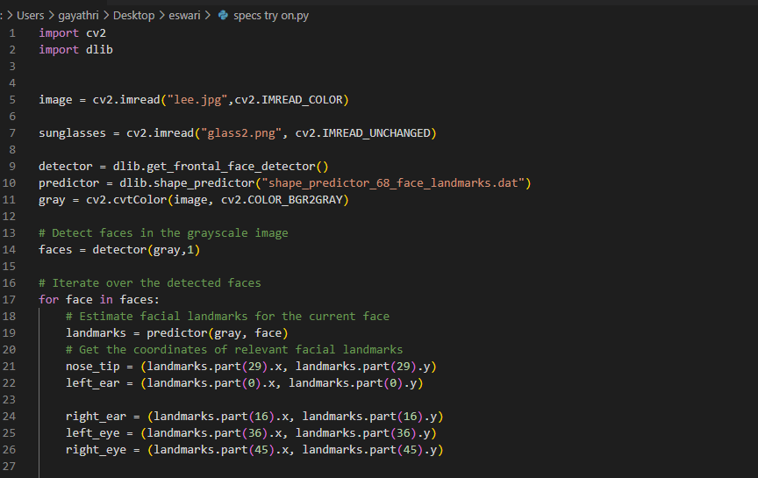
Code for spectacles Try on:

Slide 18
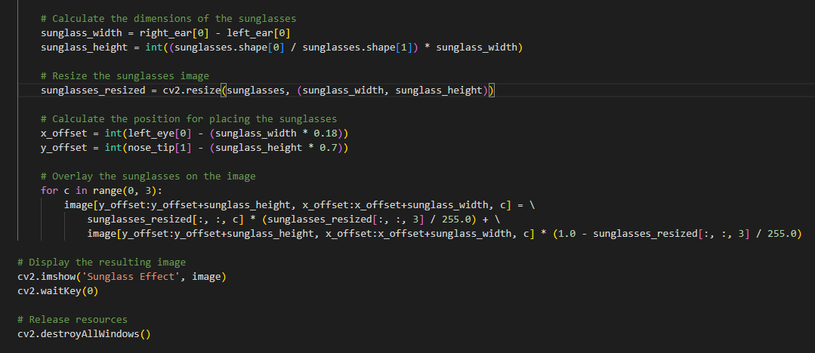

Slide 19
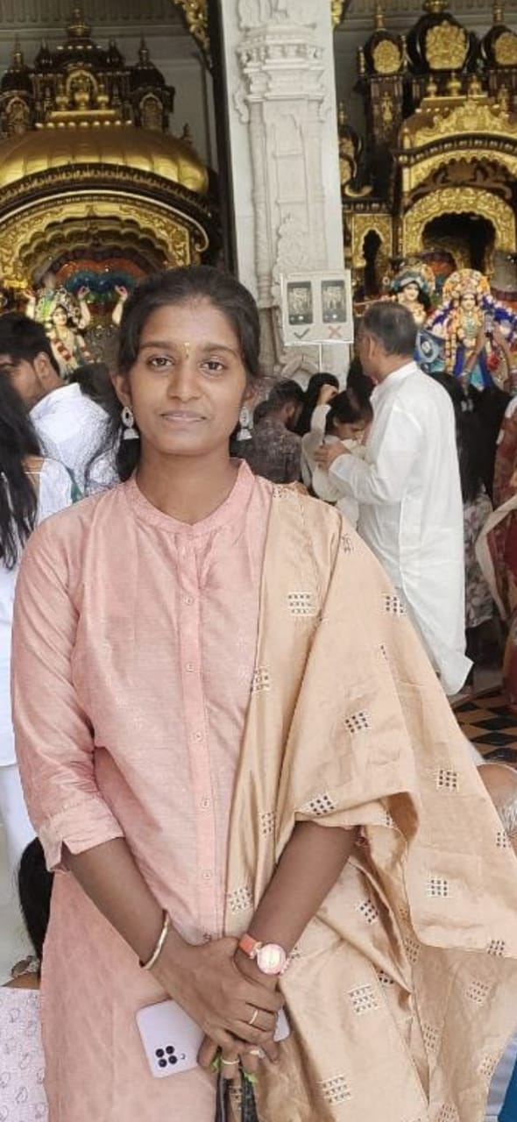
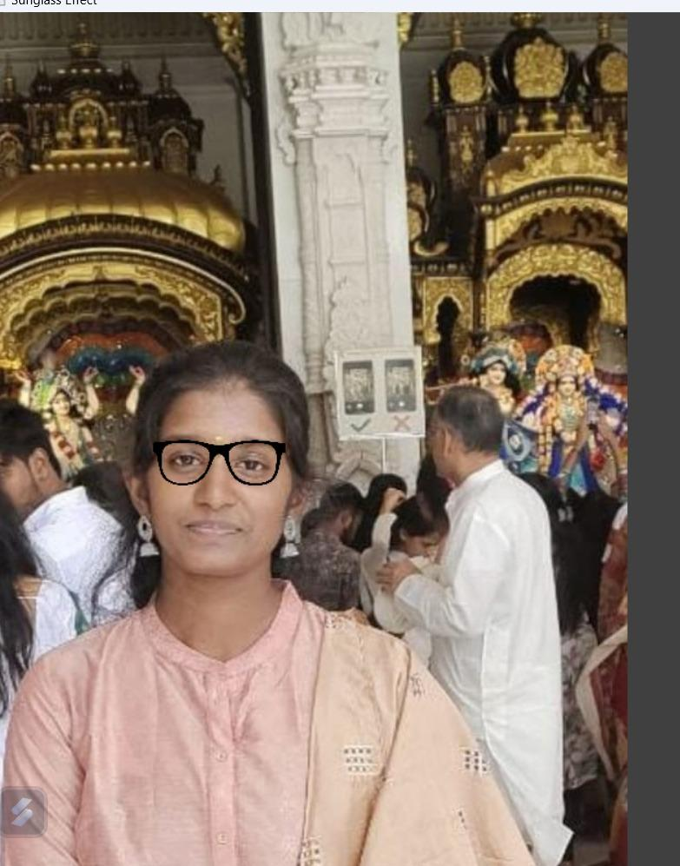
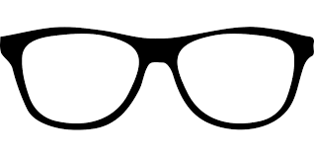
Input images:
Output Image
=
+

Slide 20
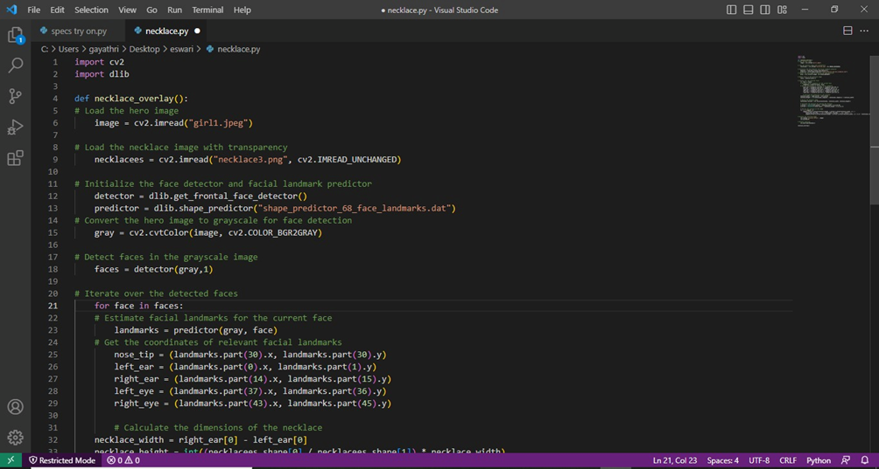
Code for Necklace Try on:

Slide 21
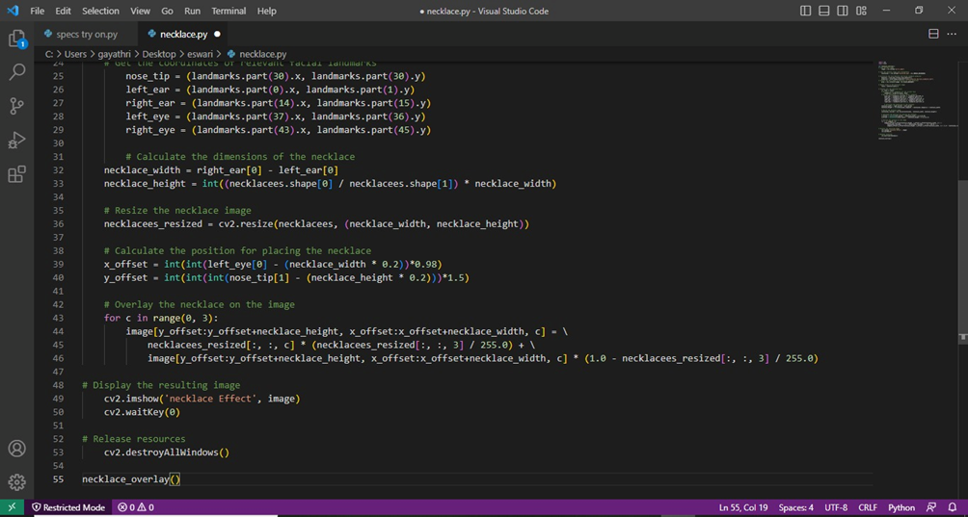

Slide 22
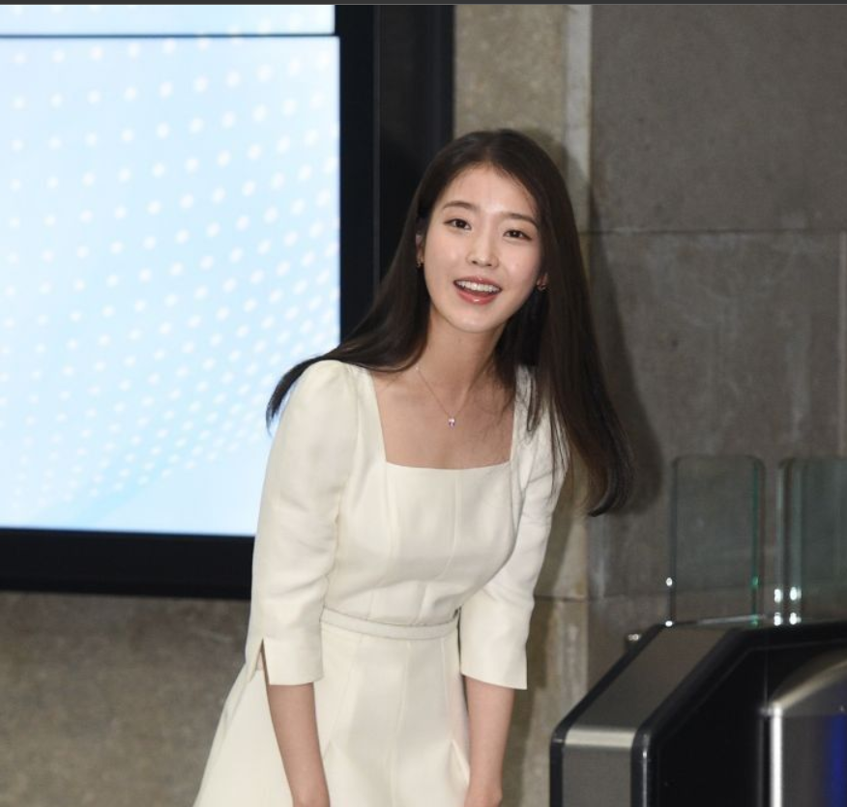
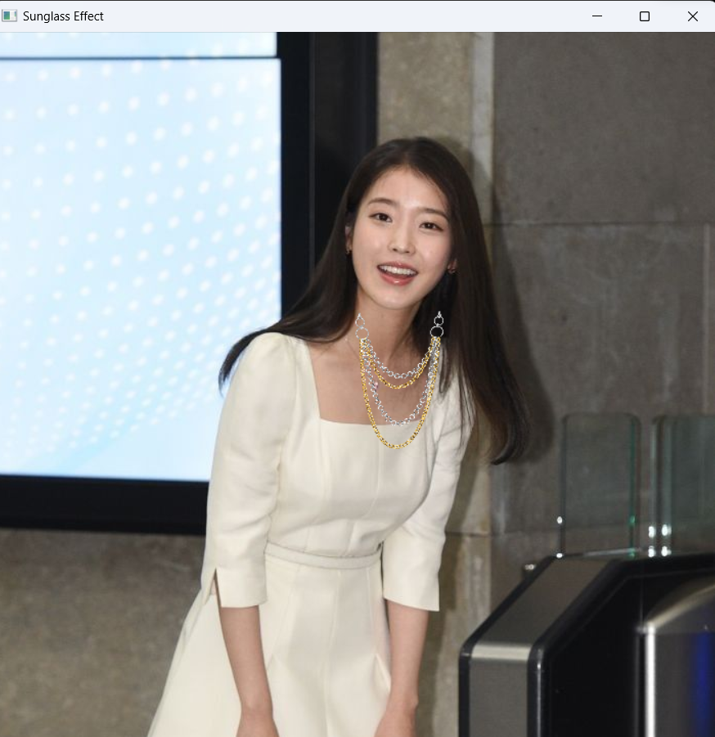
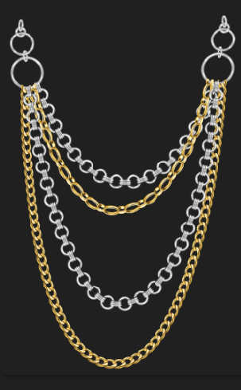
Input Images:
Output Image
+
=

Slide 23
Conclusion:
In conclusion, virtual try-on using 2D image overlaying is a game changer for online shopping of glasses and necklaces. It helps solve the problem of buying these items without trying them on first, and provides an easy and convenient way to do so from the comfort of your own home.
By using this technology, you can save time and money, and have a better shopping experience overall. So next time you're in the market for new glasses or necklaces, give virtual try-on using 2D image overlaying a try. You won't be disappointed!

Slide 24
References:
https://chat.openai.com/
https://contribute.qt-project.org/
https://www.qt.io/
www.google.comm
www.youtube.com (Code First with Hala, Jie Jenn)

Slide 25
Acknowledgement
We would like to express our deepest gratitude to everyone who contributed to the successful completion of the virtual try-on project. Without their support, expertise, and dedication, this project would not have been possible.
First and foremost, We extend our heartfelt appreciation to our guide Krishna priya mam.

